Slide 1
ESSC4510 Project
Quantitative Verification
for Seasonal Forecast by the Hong Kong Observatory
Alan Li - 1155092891
Mavis Wong - 1155100549

Slide 2
Background
HKO provides a seasonal forecast for seasonal average Temperature and cumulative Rainfall compared to 30 year climatological normal.
8 seasons have been forecasted. (n = 8)
⇒ From Mar 2019 to Feb 2021
Different normal is used for different time:
Spring 2019 to Autumn 2020: 1981-2010 climatological normal
Winter 2020/21: 1991-2020 climatological normal

Slide 3
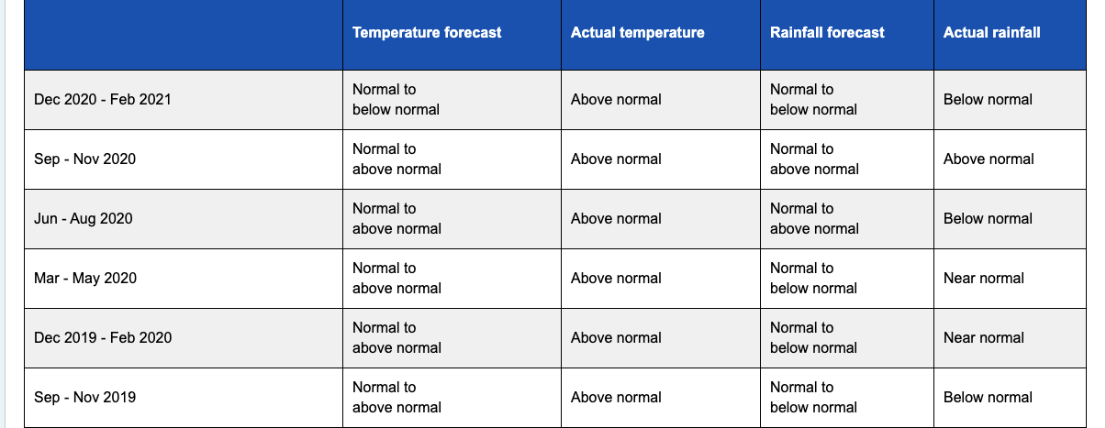
Forecast and Observation Classification
Observation Categories
Below normal (BN)
Near Normal (NN)
Above Normal (AN)
Forecast Categories
1. Normal to above normal
2. Normal to below normal

Slide 4
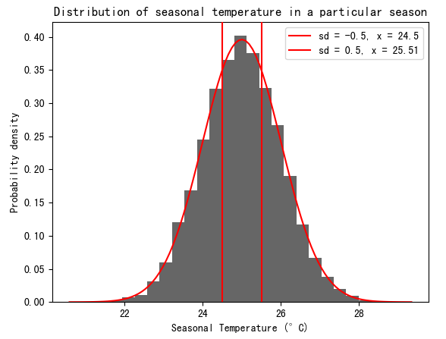
Definitions
(Simulated data, for demonstration only)
Below Normal:
< -0.5σ (~30% bottom)
Near Normal:
< |0.5σ| (~40% middle)
Above Normal:
< +0.5σ (~30% top)
Below normal
Near normal
Above normal

Slide 5
Study Goal
Design a quantitative method to verify the seasonal forecasts using historical observational data.

Slide 6
Common Forecast Verification Methods
Some common methods for forecast verification:
Contingency Table
Hit Rate (HR) / False Alarm Rate (FAR) / Hanssen and Kuipers Score (Ks)
 |  | Observation
 |  | Normal to Below-Normal | Normal to Above-Normal
Forecast | Normal to Below-Normal | 0 (a) | 1 (b)
 | Normal to Above-Normal | 0 (c) | 7 (d)
Limited Data (Only 8 forecast available)
Result = NaN

Slide 7
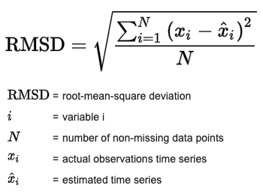
Common Forecast Verification Methods
Function-based Statistics: Root Mean Square Deviation (RMSD)
Assign larger weight to larger errors
No actual prediction value
Not suitable for Multi-category forecasts

Slide 8
Methodology
Step 1: Data Acquisition and Preprocessing:
Send HTML GET requests to HKO’s backend server
https://www.hko.gov.hk/cis/dailyExtract/dailyExtract_{year}.xml
1980 <= year <= 2021
Use pandas to format the data nicely in csv form

Slide 9
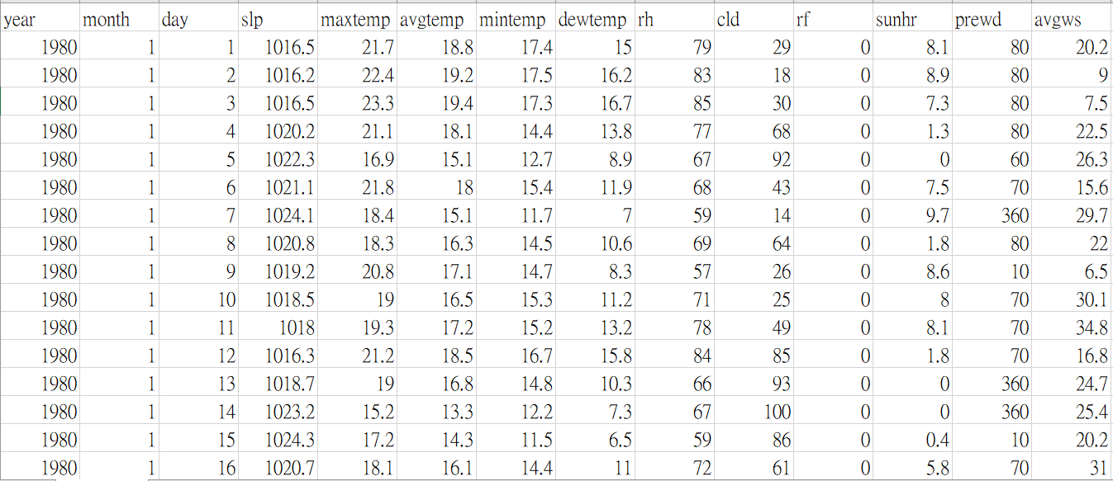
Methodology
Daily data → Seasonal data (for precision)
Average temp
Rainfall

Slide 10
Methodology
Why use daily data? Not monthly data?
Loss of Information due to averaging
Consider the following data to illustrate the problem:
Daily:
January: {19.9°C x 15 d, 20.0°C x 16 d}
February: {21.9°C x 14 d, 22.0°C x 14 d}
March: {23.9°C x 15 d, 24.0°C x 16 d}
⇒ Seasonal average = 21.95°C ± 0.05°C
Monthly:
January: 20.0°C
February: 22.0°C
March: 24.0°C
⇒ Seasonal average = 22°C ± 0.05°C
0.05°C bias for Monthly Data seems a little
But consider that σ = O(0.1°C), this is important.
To be much more precise (possibly done by HKO), we should calculate monthly data from minutely data if data is available.

Slide 11
Methodology
Slight observation:
The mean seasonal-averaged temperature of newer data has increased in all seasons, compared to older data.
Fit normal distribution N(µ,σ) for seasonal-averaged temperature
Seasonal-averaged temperature (°C)
 | µ | σ
Spring | 22.5 | 0.739
Summer | 28.0 | 0.337
Autumn | 25.0 | 0.441
Winter | 17.0 | 0.759
Seasonal-averaged temperature (°C)
 | µ | σ
Spring | 22.9 | 0.641
Summer | 28.6 | 0.440
Autumn | 25.3 | 0.473
Winter | 17.3 | 0.815
Derived from 1981-2010 Data
Derived from 1991-2020 Data

Slide 12
Methodology
Slight observation:
Coefficient of variation Cv = σ/µ is larger for rainfall than temperature.
⇒ The spread of rainfall can be larger.
Fit normal distribution N(µ,σ) for seasonal-cumulative rainfall
Seasonal-cumulative rainfall (mm)
 | µ | σ
Spring | 548 | 272
Summer | 1245 | 481
Autumn | 460 | 194
Winter | 103.5 | 80
Seasonal-cumulative rainfall (mm)
 | µ | σ
Spring | 517 | 256.5
Summer | 1319.5 | 448.5
Autumn | 477 | 227.5
Winter | 102.5 | 70.5
Derived from 1981-2010 Data
Derived from 1991-2020 Data

Slide 13
Methodology - Temperature
Calculate temperature & rainfall categories by “0.5σ” rule
Temp (°C)
 | BN | NN | AN
Spring | < 22.1 | 22.1 to 22.9 | > 22.9
Summer | < 27.8 | 27.8 to 28.2 | > 28.2
Autumn | < 24.8 | 24.8 to 25.2 | > 25.2
Winter | < 16.6 | 16.6 to 17.4 | > 17.4
Temp (°C)
 | BN | NN | AN
Spring | < 22.6 | 22.6 to 23.3 | > 23.3
Summer | < 28.4 | 28.4 to 28.9 | > 28.9
Autumn | < 25.0 | 25.0 to 25.5 | > 25.5
Winter | < 16.8 | 16.8 to 17.7 | > 17.7
Derived from 1981-2010 Data
Derived from 1991-2020 Data

Slide 14
Methodology - Rainfall
Calculate temperature & rainfall categories by “0.5σ” rule
Rainfall (mm)
 | BN | NN | AN
Spring | < 412 | 412 to 684 | > 684
Summer | < 1004.5 | 1004.5 to 1485.5 | > 1485.5
Autumn | < 363 | 363 to 557 | > 557
Winter | < 63 | 63 to 143 | > 143
Rainfall (mm)
 | BN | NN | AN
Spring | < 388.5 | 388.5 to 645.5 | > 645.5
Summer | < 1094.5 | 1094.5 to 1543.5 | > 1543.5
Autumn | < 363.5 | 364.5 to 590.5 | > 590.5
Winter | < 67.5 | 67.5 to 138.5 | > 138
Derived from 1981-2010 Data
Derived from 1991-2020 Data

Slide 15
Methodology
To evaluate forecast performance quantitatively, define a “penalty score” that has the following property:
No penalty when the forecast is correct
The penalty score is larger when the observation is further from forecast
Define another final "average score” metric M that is a function of penalty score:
M(all wrong) = 0
M(all correct) = 1

Slide 16
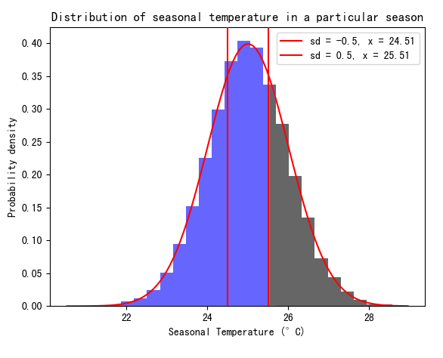
Methodology
Step 2: Z score method
The Z score of an observation with value x given by:
Z = (x - µ) / σ.
Penalty score of a forecast (below to near normal) = max(Zobs - 0.5, 0)
Penalty score of a forecast (above to near normal) = -min(Zobs + 0.5, 0)
Forecast: Below to near normal
z=0.5

Slide 17
Methodology
Step 2: Z score method
Define final score given n forecasts M(n forecasts):
M = 1 - Σ (penalty score of n forecasts) / Σ (penalty score if all forecasts wrong)
Check if this satisfies:
M(all forecasts are wrong) = 0
M(all forecasts are correct) = 1

Slide 18
Methodology
Step 3: Mimic a unskillful forecast by a random generator that chooses sddddd“below or near normal” and “above or near normal” randomly
Calculate M(random forecast) for many trials
To avoid the small p value from triggering a floating point underflow*, N=100 was chosen for the analysis.
Compare M(HKO forecast) and M(random forecast)
*: A too tiny number cannot be digitally represented with the float data type, and thus represented as 0

Slide 19
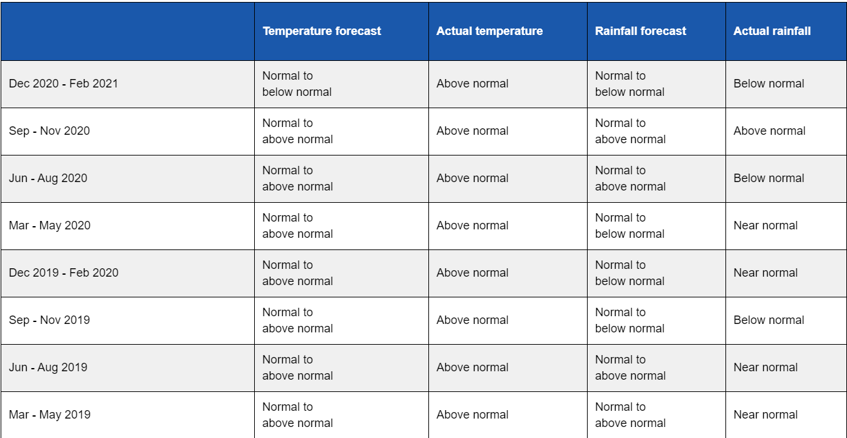
Results

Slide 20
Results
 | Temperature |  |  |  | Rainfall
2019 | Forecast | Actual | Zactual | Penalty | Forecast | Actual | Zactual | Penalty
Spring | N/AN | AN | 2.40 | 0 | N/AN | AN | 0.703 | 0
Summer | N/AN | AN | 2.39 | 0 | N/AN | NN | 0.154 | 0
Autumn | N/AN | AN | 3.43 | 0 | N/BN | BN | -1.34 | 0
Winter | N/AN | AN | 3.49 | 0 | N/BN | NN | 0.153 | 0
2020 | Forecast | Actual | Zactual | Penalty | Forecast | Actual | Zactual | Penalty
Spring | N/AN | AN | 2.49 | 0 | N/BN | NN | -0.351 | 0
Summer | N/AN | AN | 4.45 | 0 | N/AN | BN | -1.55 | 1.03
Autumn | N/AN | AN | 2.28 | 0 | N/AN | AN | 3.33 | 0
Winter | N/BN | AN | 2.60 | 2.07 | N/BN | AN | 0.560 | 0.0352

Slide 21
Results
Random Model score ≈ 0.5
HKO forecast has a much higher score than Random Forecast.
Temperature Forecast has a higher score than Rainfall Forecast
 | HKO Forecast | Random Model
Temperature | 0.893 | 0.493
Rainfall | 0.772 | 0.496

Slide 22
Result: T-test
H0: The scores of the HKO Seasonal Forecast does not differ from that of the Random Forecast
H1: The scores of the HKO Seasonal Forecast differs from that of the Random Forecast
Both p-value is <0.05, H0 is rejected.
The scores of HKO Seasonal Forecast is significantly different from that of Random Forecast
 | Temperature | Rainfall
p-value | 5.4 x 10⁻⁴⁰ | 1.6 x 10⁻¹²

Slide 23

Hit skill score
T-test can only show the seasonal forecast by HKO is better than random forecast.
It does not show HOW the seasonal forecast by HKO is better than random forecast.
Hit Skill Score:
Compare the quality of the forecast with the random model
Calculate the relative accuracy of the forecast over the random model forecast.

Slide 24
Hit skill score
Score Interpretation:
100% : High resolution, prediction is always correct.
0% : No Resolution, There is no difference between the forecasts
-100% : High resolution, but the prediction always miss.
For Temperature, HKO Forecast is around 76% more accurate than the Random Forecast.
For Rainfall, HKO Forecast is around 47% more accurate than the Random Forecast
 | Temperature | Rainfall
Hit Skill Score | 75.67 % | 46.81 %

Slide 25
Conclusion
Z-Score:
Temperature forecast has a higher score than Rainfall Forecast
HKO Seasonal Forecast has a higher score than the Random Forecast.
T-test:
The scores of the HKO Seasonal Forecast differs from that of the Random Forecast.
Hit Skill Score:
HKO Seasonal Forecast is more accurate than the Random Forecast.
Temperature forecast has a higher accuracy and resolution than Rainfall Forecast

Slide 26
Limitation
3 categories in actual observations and 2 categories in forecast
HKO can get a high score if the observation is always “Near normal”.
A high score does not mean a useful forecast:
the forecast is categorical and there are only 2 categories
Small sample size (only 8 data)
We can only estimate seasonal average from daily data (averaging error)

Slide 27
References
Forecast Verification - Issues, Methods and FAQ. (n.d.). Retrieved April 20, 2021, from https://www.cawcr.gov.au/projects/verification/
Seasonal Forecasting - Use and interpretation. (n.d.). Retrieved April 20, 2021, from https://www.hko.gov.hk/en/wxinfo/season/intpret.htm
Recent seasonal forecasts and observations. (n.d.). Retrieved April 20, 2021, from https://www.hko.gov.hk/en/wxinfo/season/fcvsobs_seasonal.htm
Mason, S. J. (2013). Guidance on verification of operational seasonal climate forecasts. World Meteorological Organization, Commission for Climatology XIV Technical Report.
World Meteorological Organization. (2014). Forecast verification for the African severe weather forecasting demonstration projects.

